Slide 1
Detection of Anomalies in Review and Ratings for Amazon Products
Submitted by:
Charu Goyal
Navin Ram Kumar
Neha Seth
Prachi Agarwal
Ramakrishnan Subramanian
Mentor: Mr Koneti Naveen Kumar Yadav

Slide 2
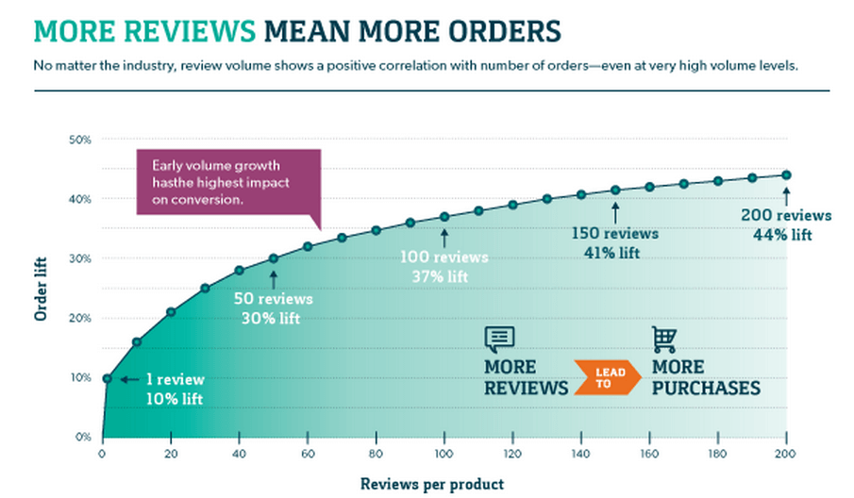
Problem Statement
The objective is to identify any inconsistencies or anomalies between the ratings and the reviews given by a customer, thereby confirming if the rating is in line with the review.
SourcsSOur
Source: blog.3dcart.com
2

Slide 3
DataSet: Features & Info
The online reviews for Amazon.com data has been procured from Kaggle having 67,992 records and the following ten attributes:
In addition to this, have also used the combined 3000 reviews of IMDB, Yelp.com and Amazon.com that details reviews labelled with sentiment score. This dataset was created for the paper From Group to Individual Labels using Deep Features, Kotzias et. al,. KDD 2015
name | name of the product
categories | name of the categories
PrimaryCategories | name of the Primary Categories
reviews.dated | date of the review
reviews.rating | ratings given by the user for the product
review.text | text review given by the user for the product
reviews.title | title of the review
reviews.username | name of the user or reviewer
reviews.doRecommend | whether the reviewer recommends the product
reviews.numHelpful | the number of people who found it helpful
3

Slide 4
Suggested Solutions to the problem
The training dataset with 3K records requires text-cleaning before Model building.
The pre-processing/ cleaning text follows certain steps such as removal of punctuations like “,”, “!” and “.” , special characters like ‘â’ , stop words like a, an, the etc. Below operations are performed to handle these exceptions:
Visualisation using word cloud positive and negative , where rating vs rating count plot is described above.
Since these records weren’t dynamic, therefore, 7k records (without anomalies) are added from the amazon dataset using the same pre-processing steps to help in better training of the model.
Lowercase
Reviews
Punctuation, Special Character removal
(using Regex)
Spelling Corrections (Using Textblob)
Lemmatization
Removing Stop words
4

Slide 5
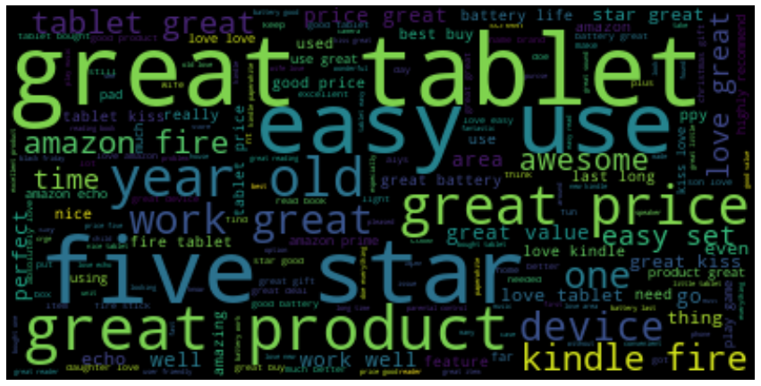
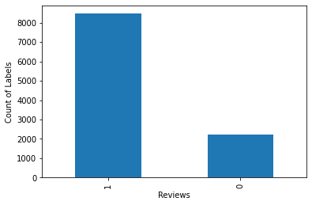
EDA
Removing 2, 3, 4 ratings from the dataset as it is impossible to rectify anomalies, visualising the dataset.
Sentiment analysis method is performed using TextBlob text polarity to make training records sufficient for model evaluation.
Rating vs count of rating.
WordCloud – Most used words
Count of 1 and 5 ratings
5 1
Ratings

Slide 6
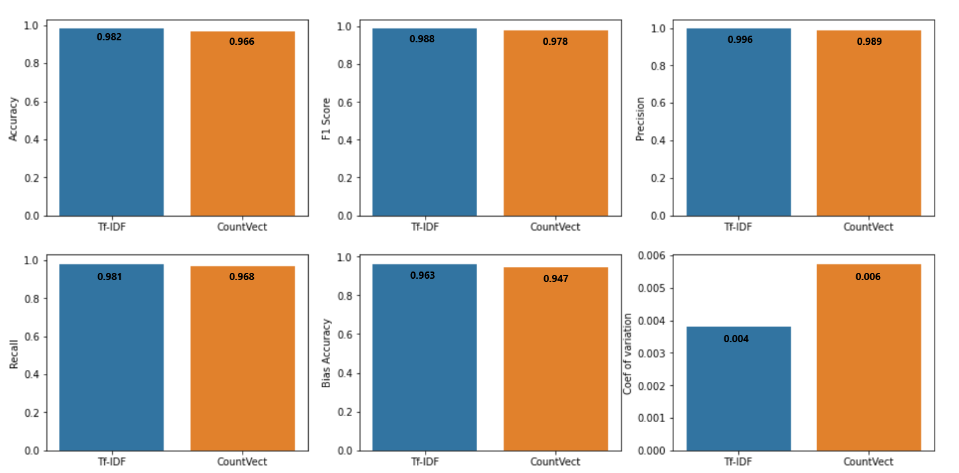
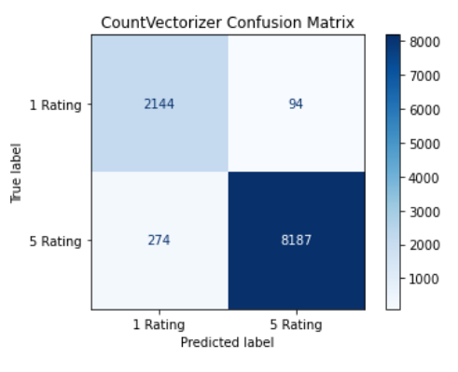
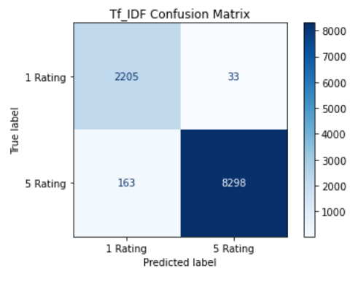
Text to Number Model
TF-IDF & Count Vectorizer Comparison – XGB Boost Model
Metrics scores of TF-IDF are better, therefore it is chosen for Text to numeric conversion

Slide 7
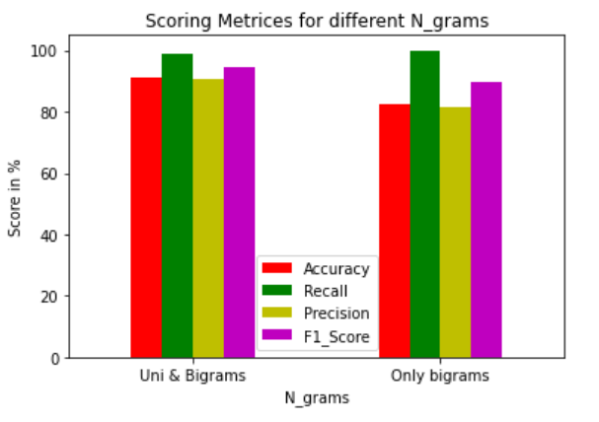
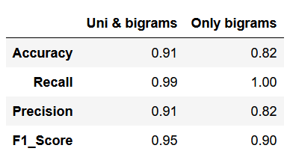
Selection of N_Grams
Combination of unigrams & bigrams and only bigrams are taken for analysis
Only recall is 0.009% higher for only bigrams over uni & bigrams combo, otherwise all other performance metrices are higher for uni & bigrams combo.
Therefore, selecting the uni and bigram combination as the n_grams.

Slide 8
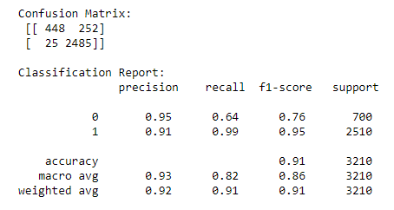
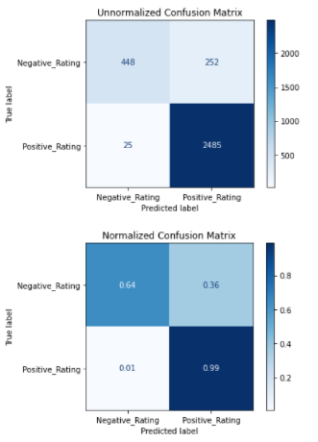
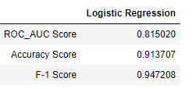
Base Model- Logistic Regression
7

Slide 9
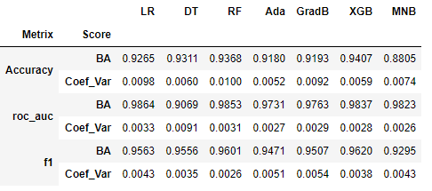
K-Fold Cross Validation
In order to achieve the best results different linear and non-linear models on the basis of different scoring metrics namely: Accuracy, Roc_Auc, F1-Score were build using K-Fold Cross Validation, where Number of Splits is considered as 7.
For both Accuracy & F-1 Scoring metrics, XGB Classifier gives the best Bias Accuracy and Variance Error Trade Off.
Note: The above results were obtained using the default parameters for all the seven models.
8

Slide 10
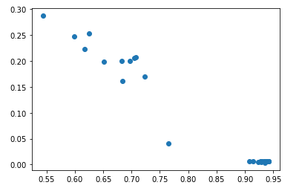
Hyperparameter Tuning
Since XGB Classifier gave the best Bias Accuracy (BA) and Variance Error (VE) Trade off. Thus choosing the best hyperparameters using Grid- Search CV. The 3 main hyperparameters considered are : n_estimators, max_depth, learning_rate.
Bias Accuracy & Variance Error Trade Off
BA > 0.94 & VE < 0.006 gives the best combination of hyperparameters which are:
n_estimators : 200
max_depth : 15
Learning_rate: 0.1
Variance Error
Bias Accuracy
9

Slide 11
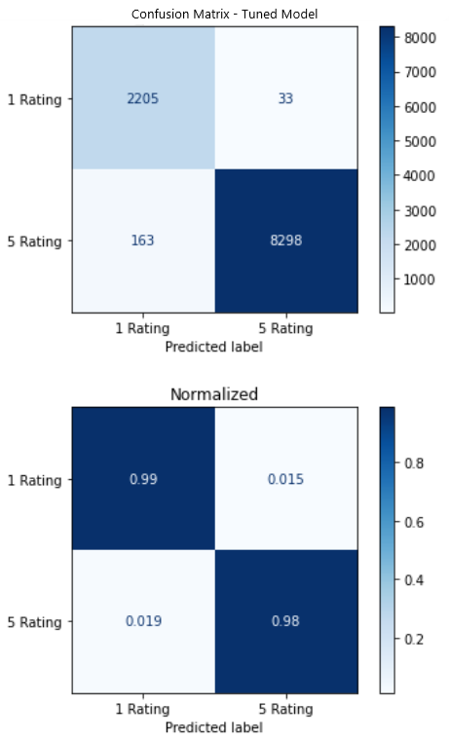
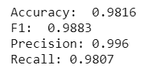
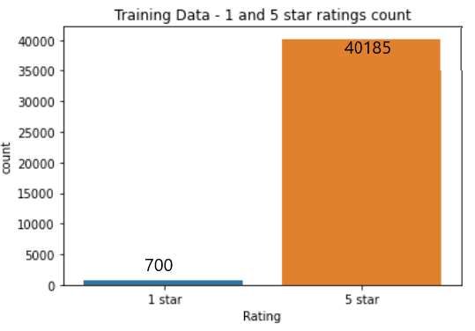
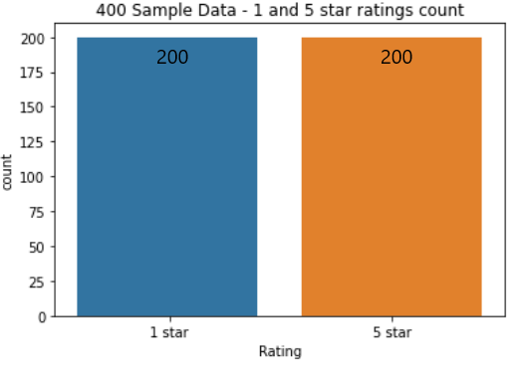
Tuned Model’s performance & Test data Sampling
Model: XGB Boost
Identifies 1 & 5 rating based on the textual sentiment.
Reviews invoking sarcasm, praising/degrading other items or are meaningless are affecting the prediction.
Bias Accuracy: 0.963
Coef. Var: 0.0038
Testing data – Sampling
Margin of error: 5%
Confidence level: 95%
Population size: 40885
Expected Sample proportion: 10% (that has anomaly)

Slide 12
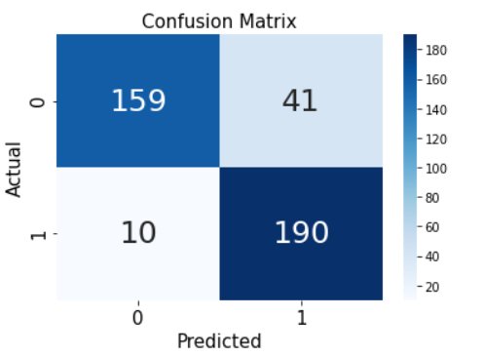
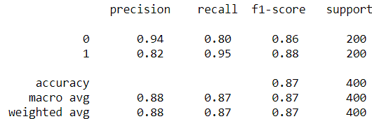
Model applied on the test results
After applying the model on the test set the obtained results were:
The above results are for model predicted rating vs user provided rating.
According to the model those records that it predicted wrongly are anomalies.
Classification report

Slide 13
Model Evaluation
Examples of Anomalies
Title + Review (lemmatized and stop word removed) | Rating by user (0 or 1) | Model Predicted Rating (0 or 1) | Model Predicted Anomaly | Anomaly
granddaughter love us every day can't get enough | 0 | 1 | 1 | 1
much returned decided go model below one didn't need integrated hub feature phillips hue doe require but decided stick current insteon hub dislike | 1 | 0 | 1 | 1
liked lot liked lot liked lot liked lot | 0 | 1 | 1 | 1

Slide 14
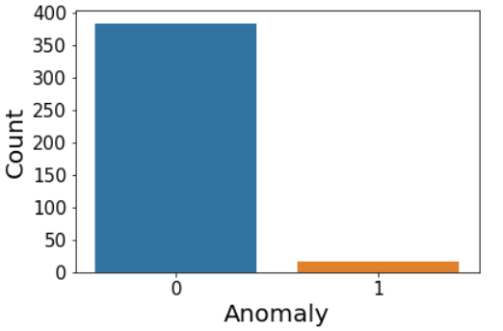
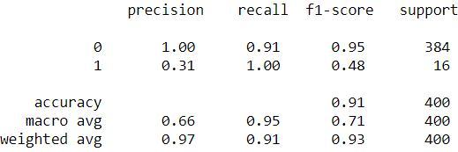
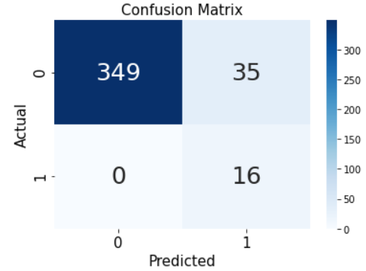
Model Evaluation
Count of Anomalies
Model is able identify all the anomalies, but it wrongly identified few non-anomalies as anomalies.
FP is high whereas FN is null.
FN is costlier for this particular business case.

Slide 15
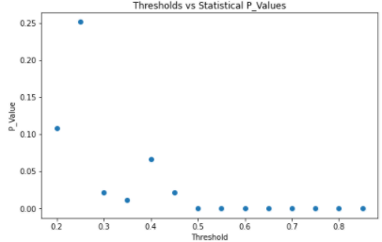
Threshold Tuning
Scoring Metric: Weighted Recall - gives information about Ratio of Correctly predicted/Total class members; handles imbalance in classes.
Hypothesis:
Null hypothesis: Weighted Recall = 0.95
Alternate Hypothesis: Weighted Recall ≠ 0.95
Condition for weighted recall = 0.95: P-value > 0.05
Statistically qualified thresholds:
0.2, 0.25 and 0.4.

Slide 16
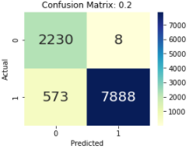
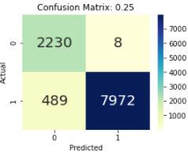
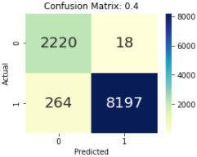
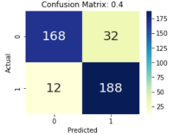
Threshold Tuning
Confusion matrix of Classification with different threshold on whole training set:
Good Trade - off between FP and FN with 0.4 threshold.
Confusion matrix of 400 randomly chosen samples.

Slide 17


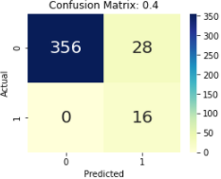
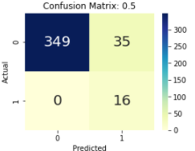
Threshold Tuning
Anomaly detection scores:
Scores for 0.4:
Scores for 0.5:
Class 1
Class 1
FP is reduced from 35 to 28 by using 0.4 as threshold instead of 0.5.

Slide 18
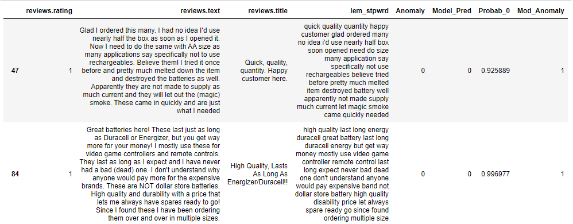
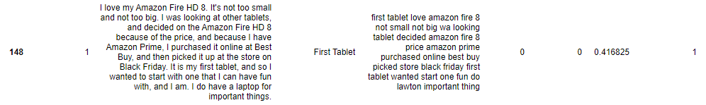
Examples of False Positives Anomalies- Positive Sentiments
Below are few examples from the 28 False Positives obtained after threshold tuning:
Positive Sentiments
In reality these sentiments are positive (5 rating one’s), however the model has predicted them as negative (0 rating) because of the extreme negative Probab_0 Scores, highlighted above.

Slide 19
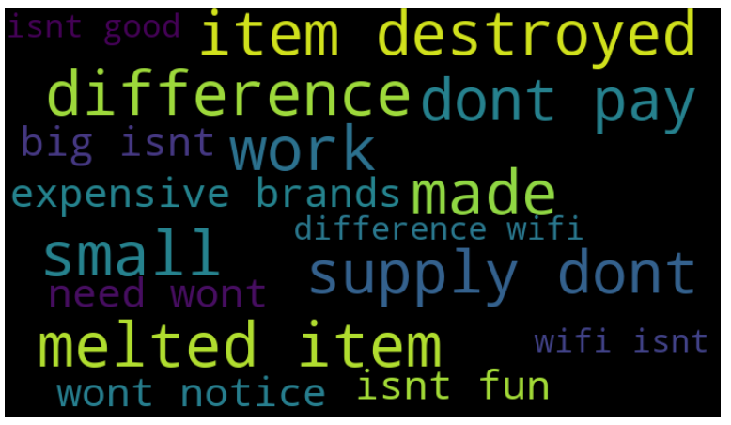
WordCloud- Positive Sentiments having Negative Words
Observation:
Above are the few words used in the Positive Sentiments, due to which the Probab_0 Score is extremely negative. Thus the actual positive review rating (i.e. Rating 5) does not match with the
Model_Pred rating (i.e. Rating 0), hence resulting in Anomalies.

Slide 20
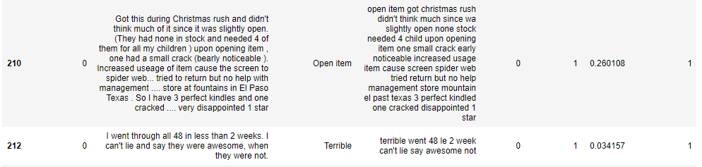
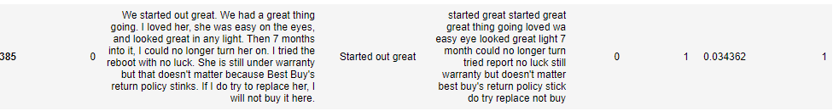
Examples of False Positives Anomalies- Negative Sentiments
Below are few examples from the 28 False Positives obtained after threshold tuning:
Negative Sentiments
In reality these sentiments are negative (0 rating one’s), however the model has predicted them as positive(5 rating) because of the extreme positive Probab_0 Scores, highlighted above.

Slide 21
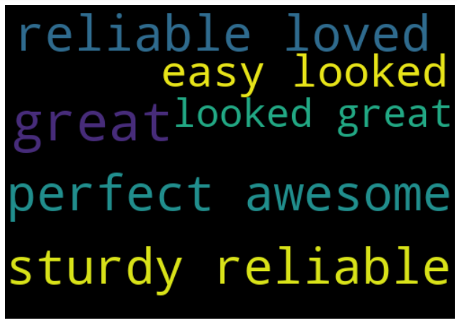
WordCloud- Negative Sentiments having Positive Words
Observation:
Above are the few words used in the Negative Sentiments, due to which the Probab_0 Score is extremely positive. Thus the actual negative review rating (i.e. Rating 0) does not match with the
Model_Pred rating (i.e. Rating 5), hence resulting in Anomalies.

Slide 22


Conclusion & Business Recommendation
After comparing all the Classification models with K-Fold Cross Validation and hyperparameter tuning XGB Classifier has the highest score. The scores are:
After tuning the threshold to different values using XGB Classifier, 0.4 threshold gave the best results. The scores are:
A significant improvement has been observed after threshold tuning for the XGB Classifier Model in order to detect and predict anomalies. The optimal threshold value is 0.4.

Slide 23
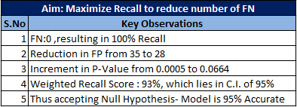
Conclusion & Business Recommendation
The objective is: “Detection of Anomalies in Review & Ratings for Amazon Products”. Thus it came to know that False Negatives (FN) are much more costlier than the False Positives (FP).
Business Recommendation:
FP only costs a message that is sent to the user whereas FN affects the users’ trust on the website as it directly affects the ratings.
So to the client, recommendation can be to send a text message/email to the user to inform them about the difference between their rating and review thus allowing them to change their rating or review. Hence, the rating will be true to users’ experience.

Slide 24
Thank You

